Slide 1
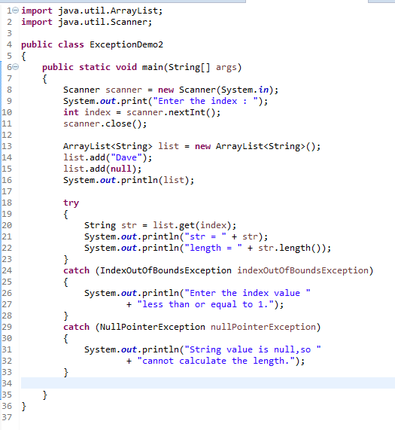
Java Multiple catch blocks
A try block can be followed by multiple catch blocks.
You can have any number of catch blocks after a single try block.
If an exception occurs in the guarded code the exception is passed to the first catch block in the list. If the exception type of exception, matches with the first catch block it gets caught, if not the exception is passed down to the next catch block. This continue until the exception is caught or falls through all catches.
At a time only one Exception is occurred and at a time only one catch block is executed.

